Slide 1
Full-Service Payment Plan Marketing Options
Increasing awareness and participation in your Payment Plan

Slide 2
Full-Service Payment Plan Marketing
Importance:
Our Goal:
Many students drop out of school or are at risk of doing so due to financial hardships. For many of these students, payment plans are a lifesaver!
We will help you communicate with your students and their families about your payment plan options.
Help you improve student success by getting the word out about this preferred payment option.
Schools who conduct marketing have more than twice as many enrollments as schools who don’t.

Slide 3
Payment Plan Marketing – Best Practices
Educate Early & Often
Educate perspective and accepted students on the benefits early. Include payment plan information in:
Financial Aid Award packages
Room & Board communications
Orientation Presentations
On your “payments” webpage(s)
Provide enrollment information early
Announce the availability of payment plans 30+ days before enrollment opens
Reach out again when enrollment opens
Send reminders right before enrollment ends
Target freshmen and students previously enrolled in a payment plan

Slide 4
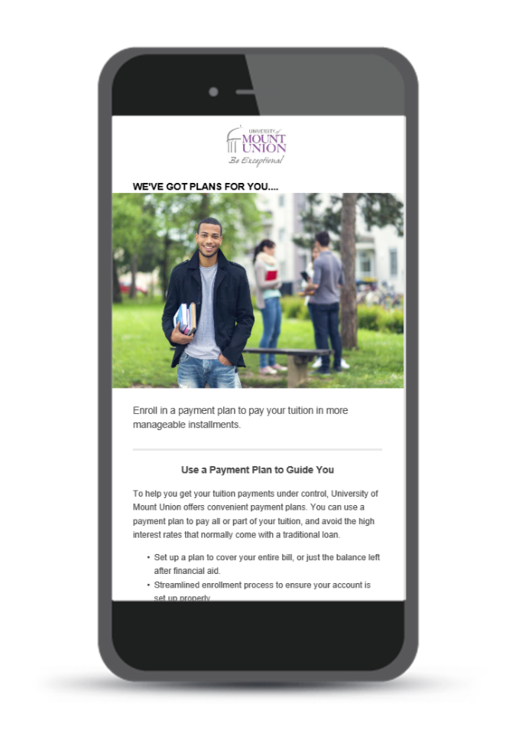
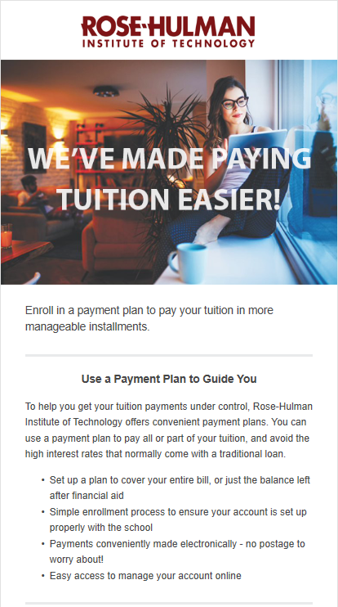
Payment Plan Marketing - Emails
Email
The most direct method of creating awareness, educating student and their families, and driving adoption.
Usually sent multiple times, leading up to and throughout the enrollment period
Appear as if they are coming directly from your institution
Versioned as needed for your campus
Securely sent from our dedicated IP address
Alternately, we can provide an HTML template you can deploy from campus.

Slide 5
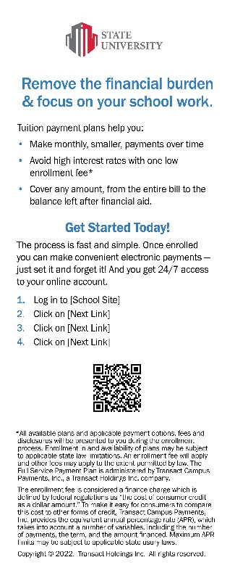
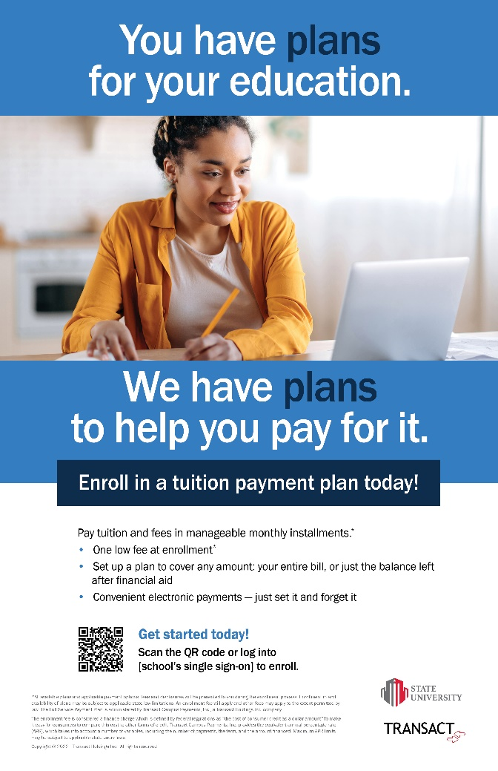
Payment Plan Marketing – Collateral
Buckslips/Inserts:
Conveniently fit into a standard envelope for easy inclusion in university sponsored mailings. Can also be used as a take-one or handed out at events.
“Your Accepted” mailings
Financial Aid award packages
Housing and meal plan mailings
Posters:
For high traffic locations and relevant offices, such as financial aid or bursar
Hang during orientation, near ID card processing
Post in student center, dorms, dining halls, etc.
Dates can be included

Slide 6
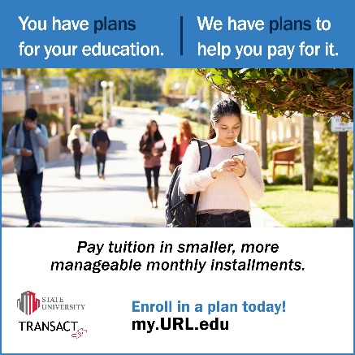
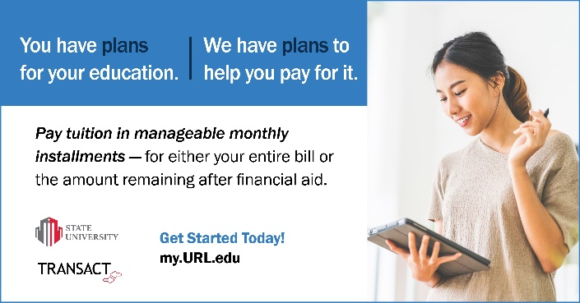
Payment Plan Marketing – Digital Media
Social media ads:
Leverage your social media channels to drive awareness and enrollments in your payment plan.
1:1 sizing usable in various social media channels
Social Media Post
Web banners:
Place on your website to drive awareness and enrollments. When clicked on, direct users to a content page or your enrollment page.
Include on all relevant .edu pages:
How to afford <schoolname> pages
Financial Aid
Bursar’s office
Orientation pages
Digital slides:
For networked monitors around campus to drive enrollments – recommend including enrollment dates and QR code
Web banner/Digital Slide

Slide 7
Payment Plan Marketing Resources
Self-service portal:
Office Hours:
Transactcampus.com/fspp
Either request that we design the materials using the templates shown, or download the design files and have your on-campus marketing team update the designs. Attach the final PDFs when you order.
Complete the form to order marketing materials
Be sure to have your logo colors, plan details and instructions handy
Easily attach artwork, logos, and other files
We will confirm receipt of order within 72 hours
Allow about 3 weeks for us to complete your order
Drop in anytime to talk with our marketing team
Tuesday, 4-5pm ET – to join: Click here to join the meeting
Thursday, 11am-12 noon ET – to join: Click here to join the meeting
Contact us via email: Engagement@transactcampus.com
Marketing services are available to you on an ongoing basis, not just for your launch

Slide 8
Send us your student email list (Format = Excel, CSV, or TXT file)
Universe: All Students
Student ID Number/Customer ID number (include any leading zero)
First Name
Last name
School email address
Year in School/cumulative credits/grad year (This is to identify freshmen vs seniors for example for results tracking)
If you have further questions, please contact your Client Manager or Engagement@transactcampus.com

Slide 9
Thank you

